Slide 1
Quadratic vs. mixed elements
Mihai Francu, University of Copenhagen
Daniele Panozzo, New York University

Slide 2
The problem
What is the best (low cost, low memory) method to use for incompressibility (with tetrahedral meshes)?
Standard FEM with quadratic (P2) elements, OR
Mixed FEM with P2/P1 or even P1/P1
Daniele: Why not use P2 all the time?
Mihai: Why not use P1/P1 for linear meshes?
Which mixed formulation for incompressible elasticity should we use?

Slide 3
Questions
How hard is it to find an experiment where P2 locks?
How can we encourage locking?
Get very close to 0.5 Poisson ratio
Low quality meshes (bad elements)
Nonlinear or anisotropic materials
Non-homongeneous bodies (stiffness distribution)
Boundary conditions and contact
How can we measure locking?
Compare error to P4 high-res baseline
Non-smooth stress distribution

Slide 4
Displacement field

Slide 5
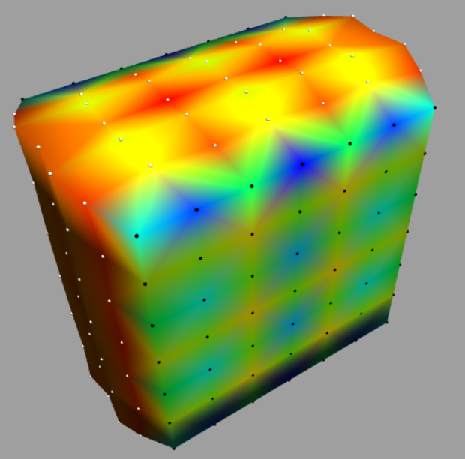
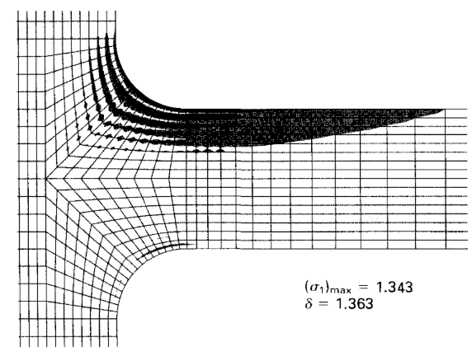
Stress field

Slide 6
Standard FEM
P1 behaves very badly
P2 behaves very well (no apparent locking)
P3 should be better
P4 is locking free according to theory

Slide 7
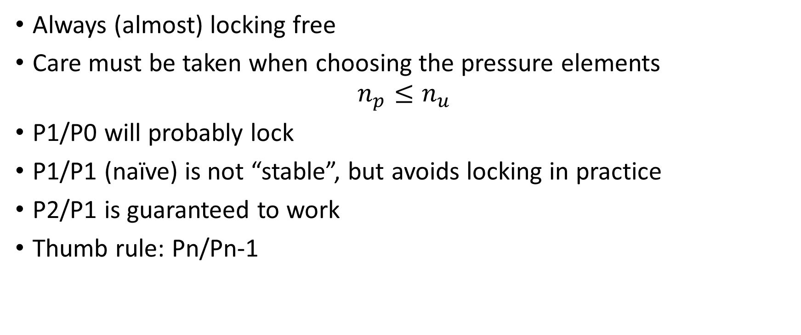
Mixed FEM
Always (almost) locking free
Care must be taken when choosing the pressure elements
$$n_{p}≤n_{u}$$
P1/P0 will probably lock
P1/P1 (naïve) is not “stable”, but avoids locking in practice
P2/P1 is guaranteed to work
Thumb rule: Pn/Pn-1

Slide 8
Solution
Compare mixed and standard FEM. : P1, P2, P3, P4, P1/P1, P2/P1
Optionally P1/P0, P2/P0
Metrics: Time, Accuracy (displacement, and stress), Memory
Validate results and ground truth

Slide 9
Experiments
Quasi-static
Compressed box with Dirichlet boundary conditions (2D,3D)
Cantilever (2D,3D)
Tube with internal pressure (2D,3D)
Plate with hole (2D)
T-beam (2D)
Two layered material, i.e. different stiffness across elements (TBD)
Some kind of dynamic experiment

Slide 10
Comparison methodology
We need to devise a way to compare FEM simulation results:
By deformed geometry (surface OBJ)
By displacement field (Paraview)
By stress field (Paraview)
Error from baseline (TBD)
VTK files and Paraview seem to be the best way to compare all.

Slide 11
Export format
Two options:
Super-sample over a linear mesh (PolyFEM)
Use the VTK file format and Paraview for any order
Both are tricky
First one is painful to replicate in every simulator
Second one assumes knowledge about of the basis functions
Paraview supports Lagrange and Bezier elements, but it’s a pain to export and vizualize the data (still possible though)
VTK with displacement and stress data at least is the winner

Slide 12
PolyFEM vs. my simulator
P1 comparisons (nu=0.49)

Slide 13
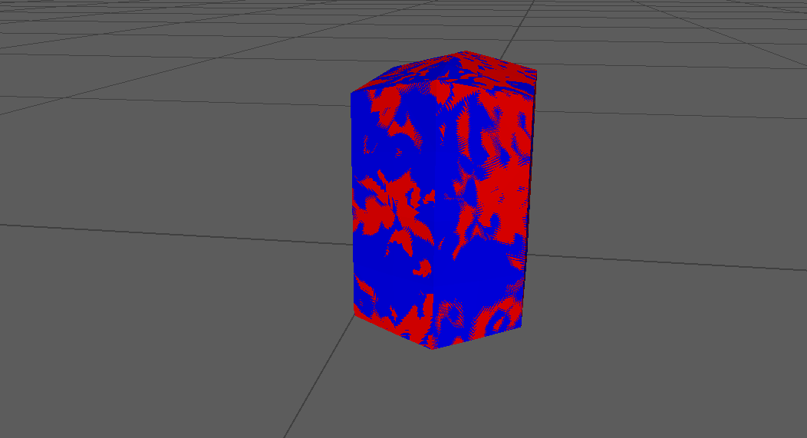
Geometry

Slide 14
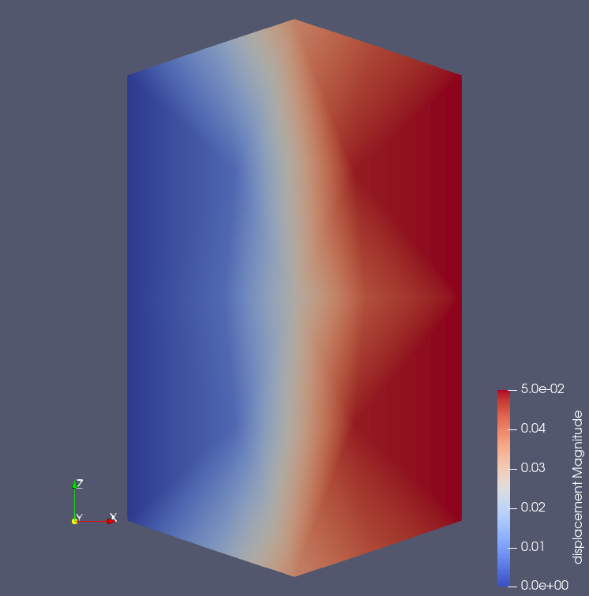
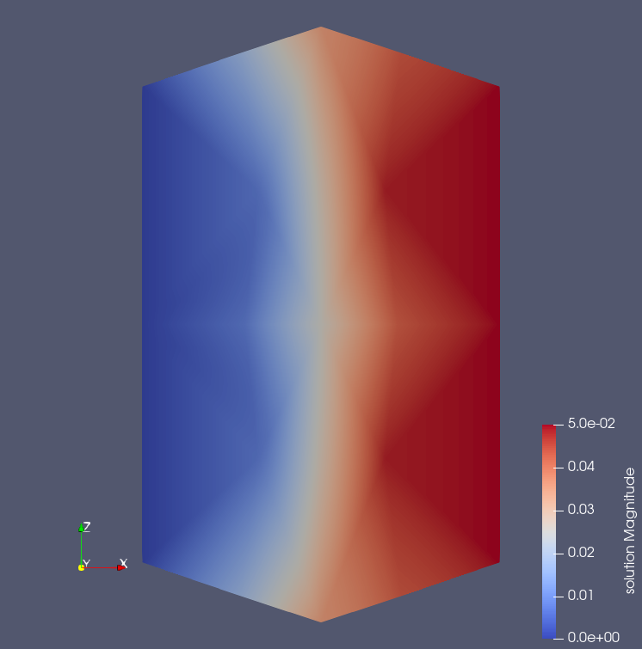
Displacement
Mine
PolyFEM

Slide 15
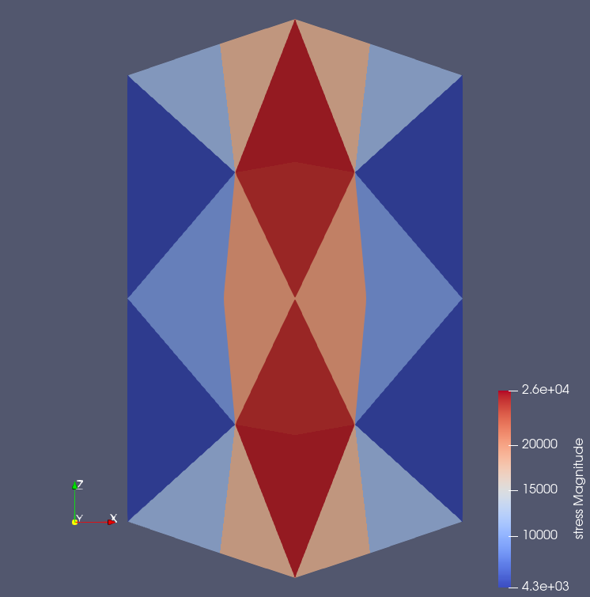
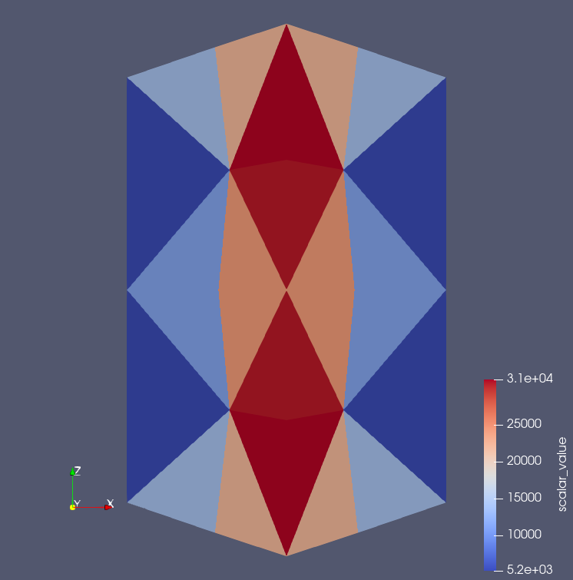
Stress (elements)
Mine (magnitude)
PolyFEM (von Mises)

Slide 16
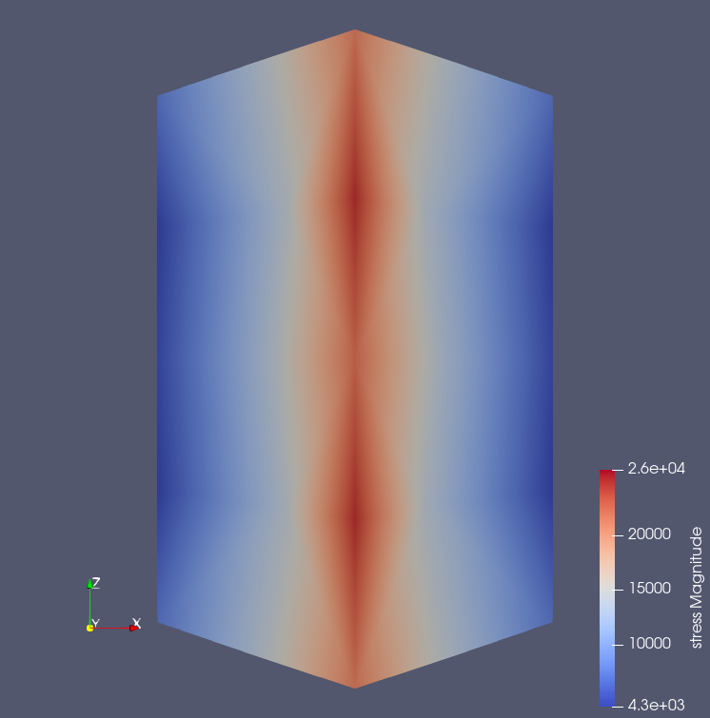
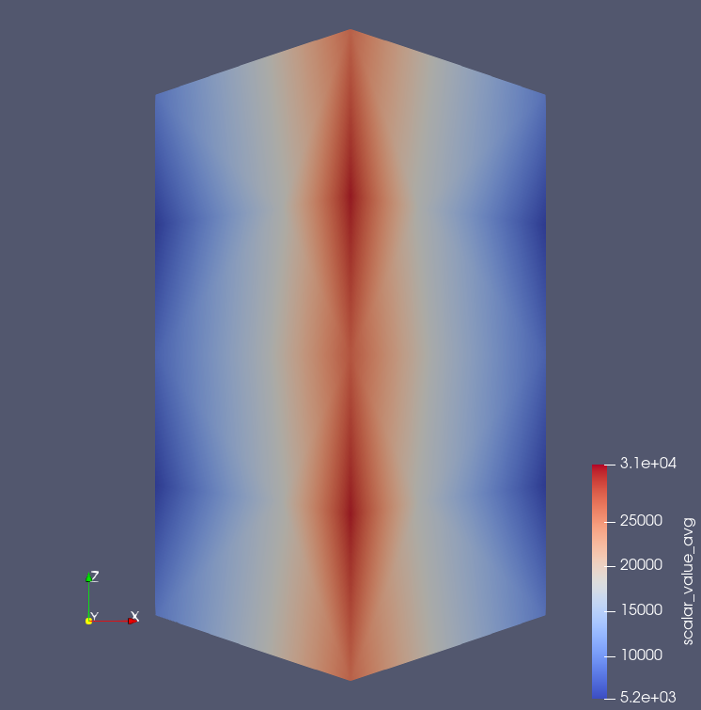
Stress (nodes)
Mine (magnitude)
PolyFEM

Slide 17
PolyFEM vs. my simulator
P2 comparisons (nu=0.49)

Slide 18
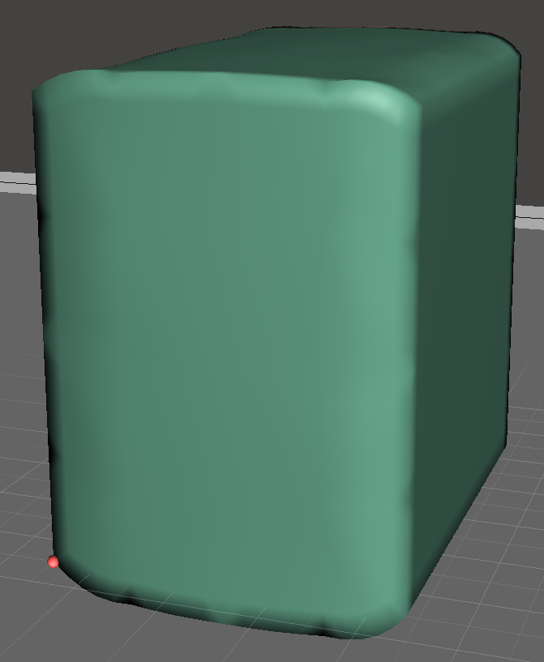
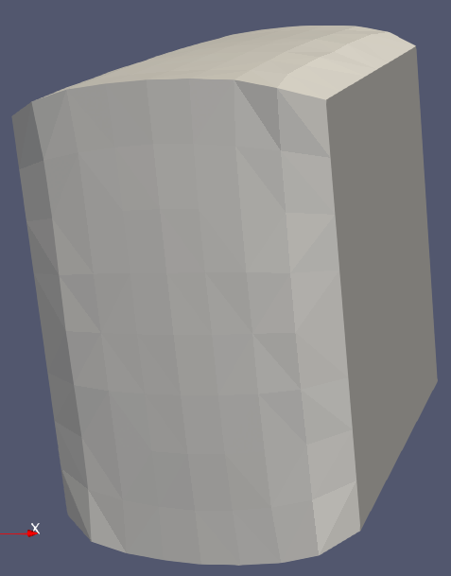
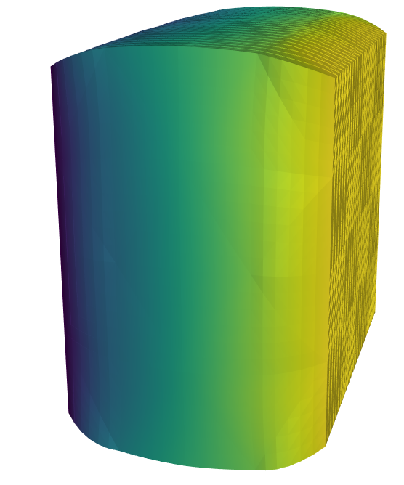
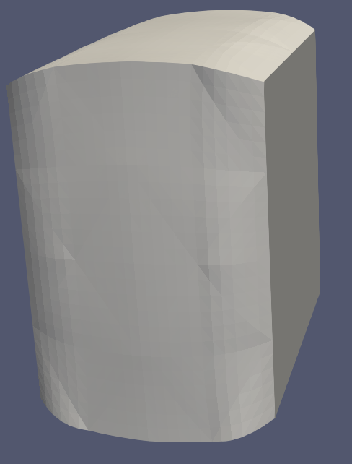
Geometry
Mine
PolyFEM

Slide 19
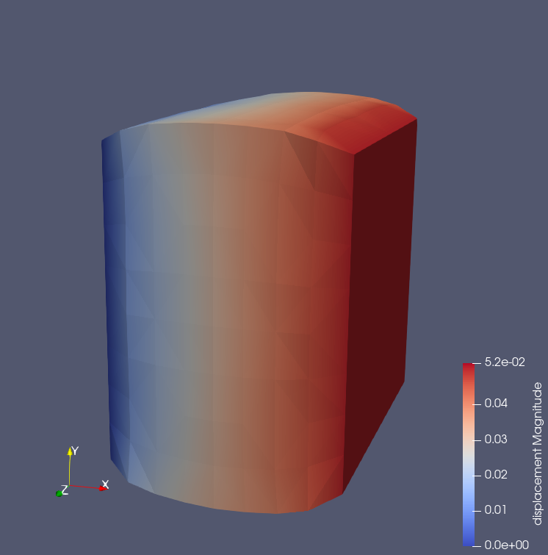
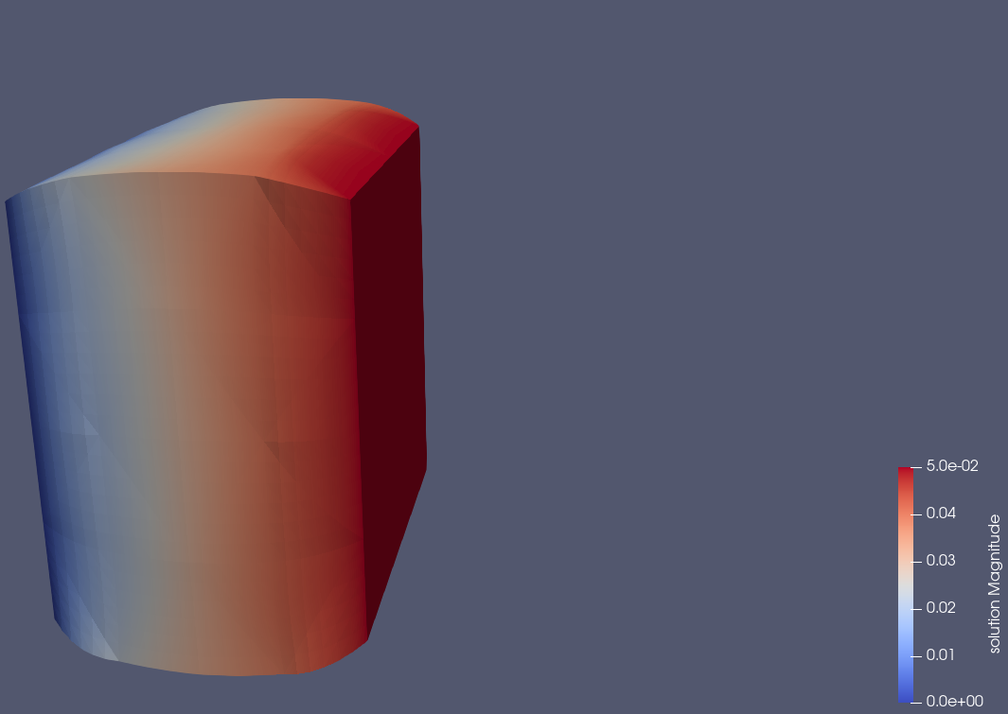
Displacement
Mine
PolyFEM

Slide 20
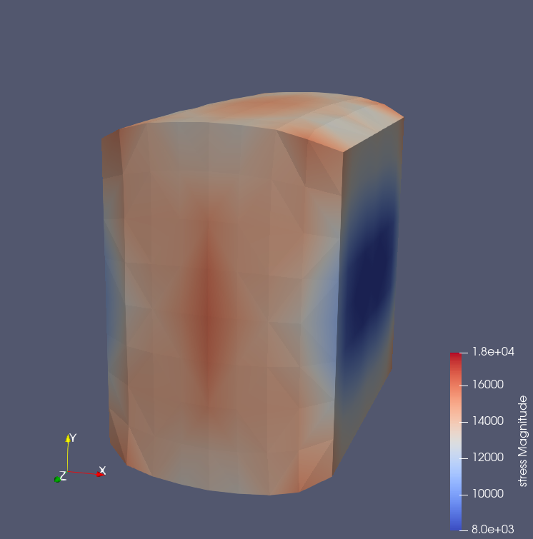
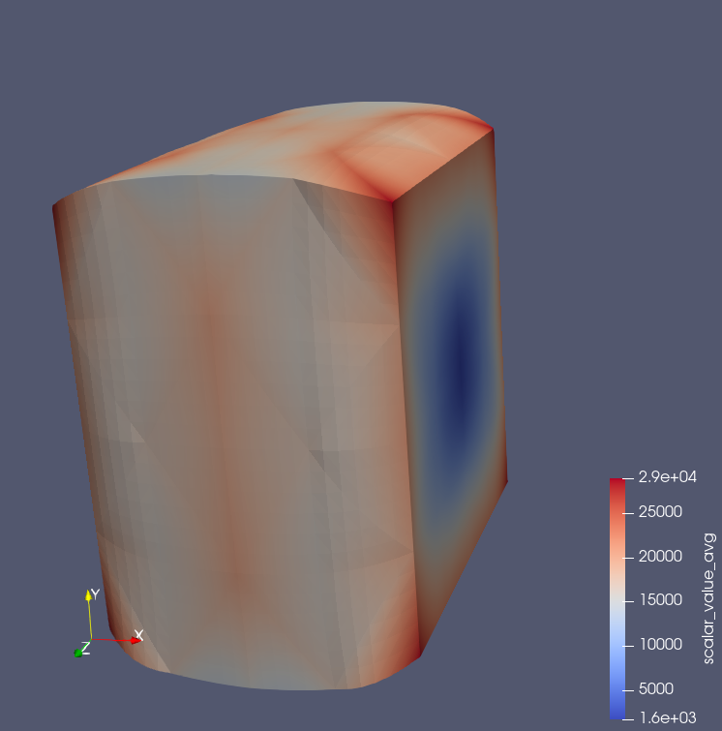
Stress (nodes)
Mine (magnitude)
PolyFEM (von Mises)

Slide 21
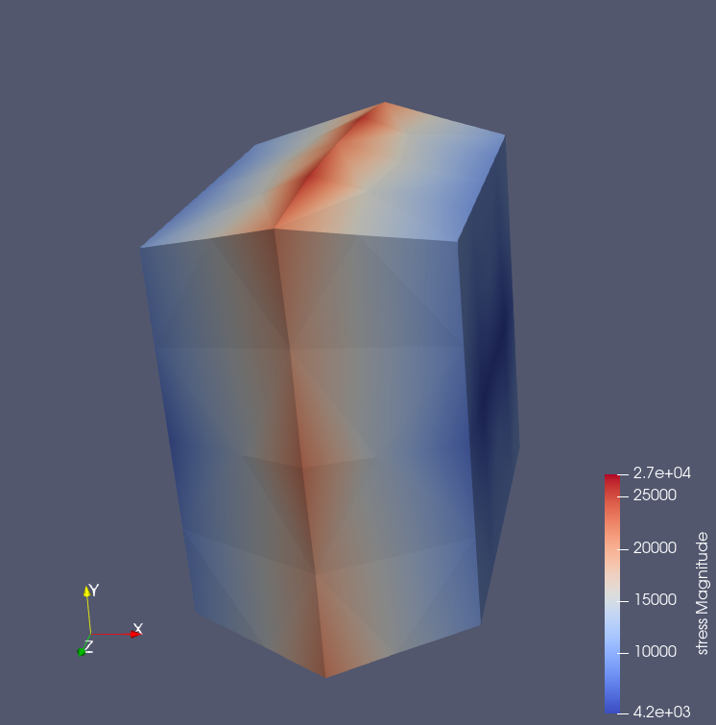
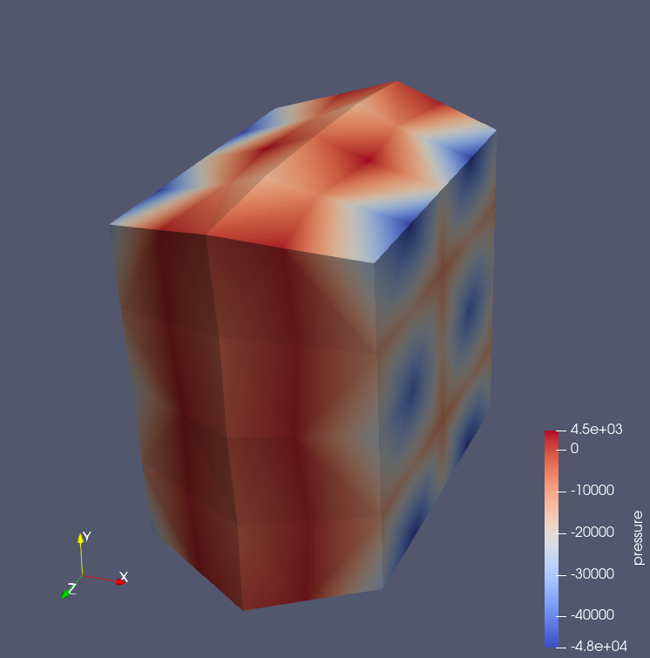
Mixed P1/P1

Slide 22
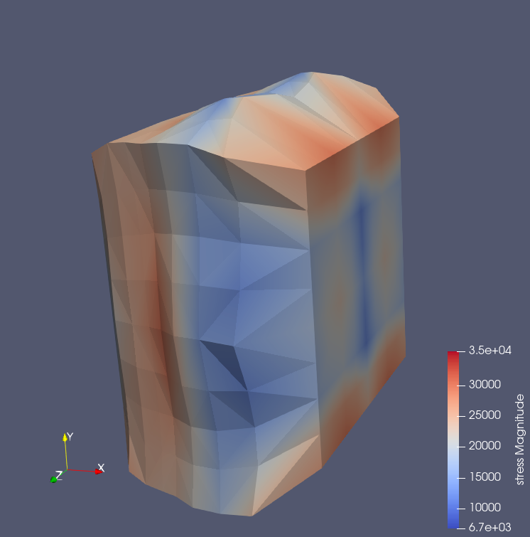
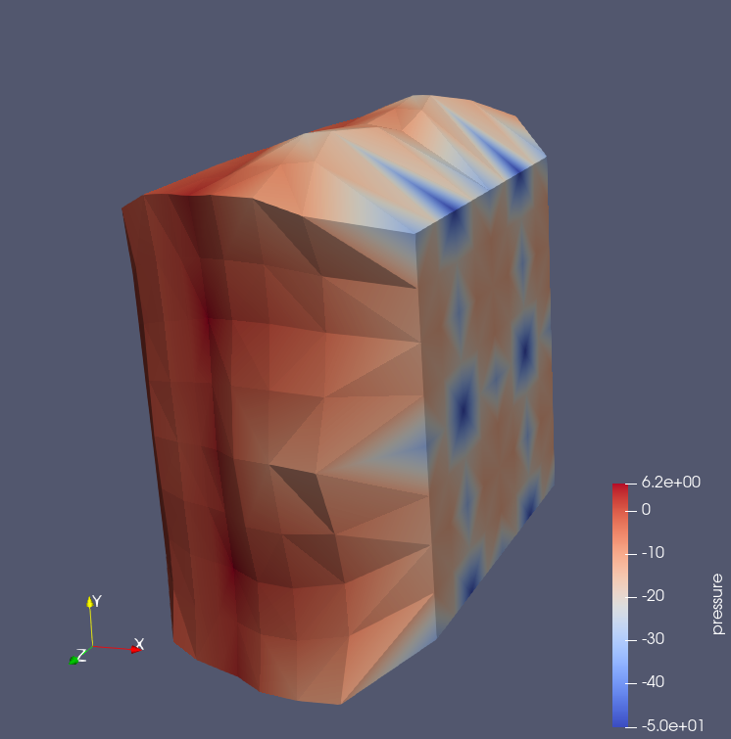
Mixed P2/P1

